Slide 1
Real-Time Time-Optimal Spacecraft Attitude Control
Author: Leonardo Eitner, M.Sc. candidate
Assistant Supervisor: Silvia Busi, PhD candidate
Head Supervisor: Prof. Dr. Marcello Romano
Context: Master’s Thesis

Slide 2
Objectives
1st
2nd
Compute the time-optimal trajectory for any attitude maneuver
Robustly obtain solutions in less than 1 second
min(maneuver_duration)
computation_time < 1 s

Slide 3


Methodology
Define system dynamics → $\left[\dot{\begin{aligned}q \\ I\dot{ω}\end{aligned}}\right]=\left[\begin{aligned}\frac{1}{2} q ⊗ \left[\begin{aligned}0 \\ ω\end{aligned}\right] \\ τ−ω×(Iω) \end{aligned}\right]$
Construct Optimal Control Problem (OCP):
Define objective/cost function →$J=T$
Define constraints → $||q||=1$
Choose OCP solver architecture
1st
Compute the time-optimal trajectory for any attitude maneuver
Legend:
$q$ → Quaternion vector
$ω$ → Angular velocity vector
$I$ → Inertia matrix
$τ$ → External torque vector
$J$ → Cost function
$T$ → Total maneuver duration
$⊗$ → Quaternion multiplication
$×$ → Cross product
$\dot{∎}$ → Time derivative
||$∎$|| → Euclidean norm
min(maneuver_duration)

Slide 4
Methodology
Choose OCP solver architecture
Solving methods:
2nd
Robustly obtain solutions in less than 1 second
 | Direct | Indirect
Approach | Discretize → Optimize | Derive optimality conditions → Discretize
Robustness | Can converge even with bad initial guess | Sensitive to initial guess
Implementation | Easier | More complex
Optimality | Approximate solution | Potentially exact
Solve speed | Real-time capable | Slow
computation_time < 1 s

Slide 5
Methodology
Choose OCP solver architecture
Direct transcription methods:
2nd
Robustly obtain solutions in less than 1 second
 | Shooting |  | Collocation
 | Single | Multiple | Direct | Pseudospectral
Dynamics Handling | Forward integration | Segmented integration | Algebraic constraints | Dense global polynomial
Accuracy | Integrator-limited | Integrator-limited | Grid density dependent | Exponential (smooth problems)
Problem Size | Smallest | Medium | Large | Large
Complexity | Simplest | Moderate | Moderate-High | Highest
Robustness | Poor | Moderate | Good | Poor (non-smooth)
Real-time Suitability | Fast but unreliable | Good balance | Solver dependent | Generally slow
computation_time < 1 s

Slide 6

Implementation
Framework: CasADi
Open-source
Automatic differentiation
Simple NLP interface
Automatic c-code generation
Source-code in c++
Extensive NLP solver compatibility

Slide 7
Implementation
NLP Solvers:
 | Interior Point | SQP Methods | SCP Methods
Warm-starting | Poor | Excellent | Good
Convergence Rate | Superlinear | Superlinear | Linear to superlinear
Problem Scale | Large-scale optimal | Medium-scale optimal | Medium-scale
Robustness | Very good | Good | Moderate
Real-time Suitability | Solver dependent | Excellent | Good
Trajectory Optimization | General purpose | General purpose | Specialized strength
Example | IPOPT, Fatrop | QRSQP, SNOPT | SCPGen

Slide 8
Implementation
Initial guess:
Single general initial guess
Initial guess library
Initial guess algorithm - PSO
A particle swarm searching for the global minimum of a function

Slide 9
Results
GPU VS CPU Dynamics Propagation
Result: CPU propagation was ~4x as fast as GPU
Reason: Problem size is not significant to justify GPU utilization overhead (N_steps = 50)
Conclusion: Propagate dynamics on CPU
Implicit VS Explicit Numerical Integration (CVODES VS RK4)
Result: Although more robust, overhead from implicit integration is overwhelmingly greater
Reason: CVODES is very heavy, even when used with CUDA
Conclusion: Use RK4 as the numerical dynamics propagator
Fatrop vs IPOpt NLP gradient-based solvers
Result: Fatrop is ~3x as fast as IPOpt
Reason: Leverages problem sparsity better by being more restrictive with NLP structure
Conclusion: Use Fatrop as the NLP gradient-based solver
CasADi automatic C-code generation VS C++
Result: C++ was ~5x slower
Reason: Compiled C-code is self-contained which reduces function calling overhead
Conclusion: Generate C-code

Slide 10
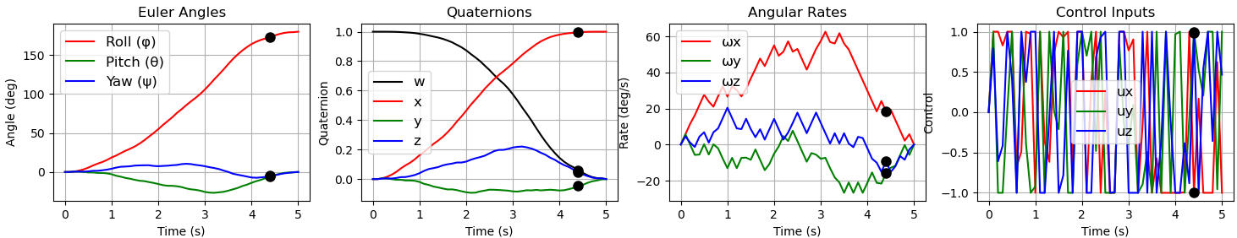
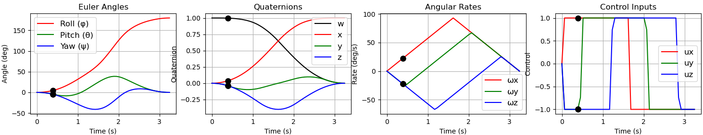
Results
PSO VS Fatrop NLP solvers
Result: (180 degree turn)

Slide 11
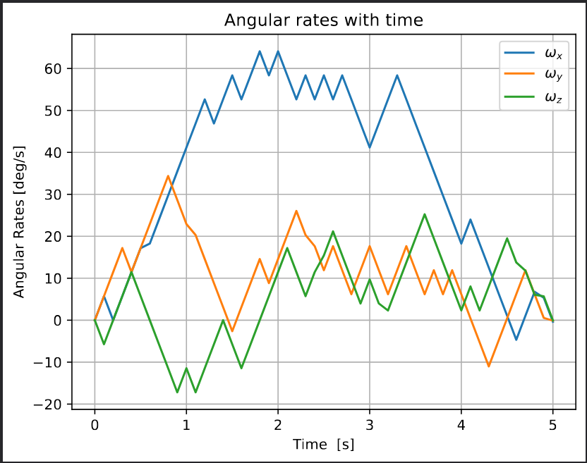
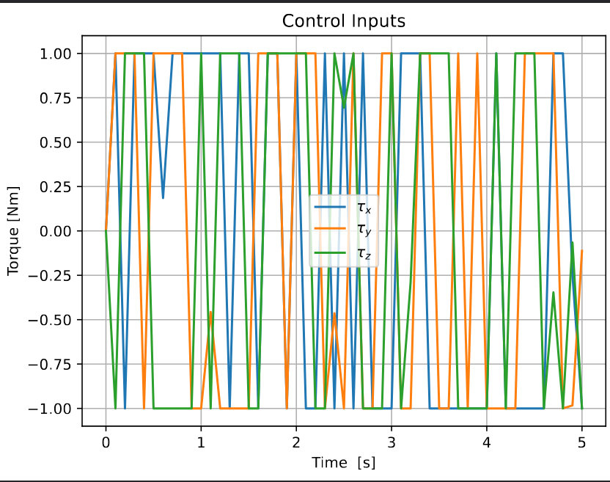
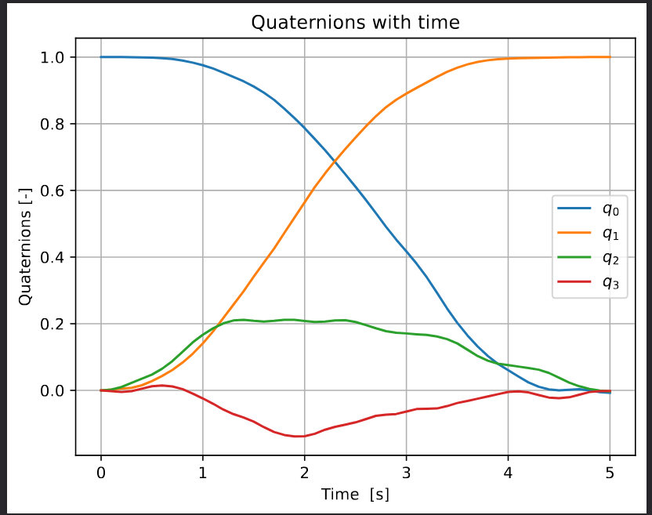
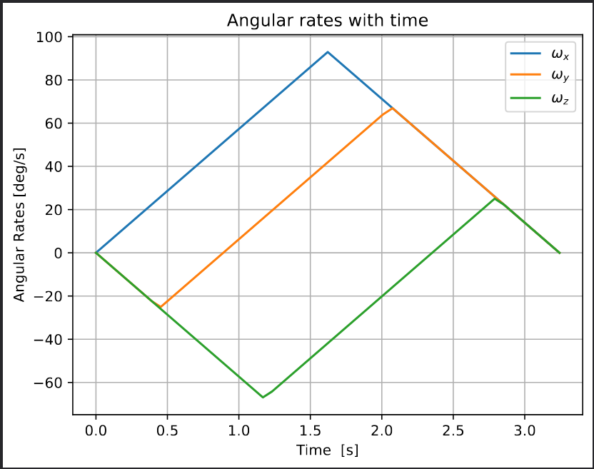
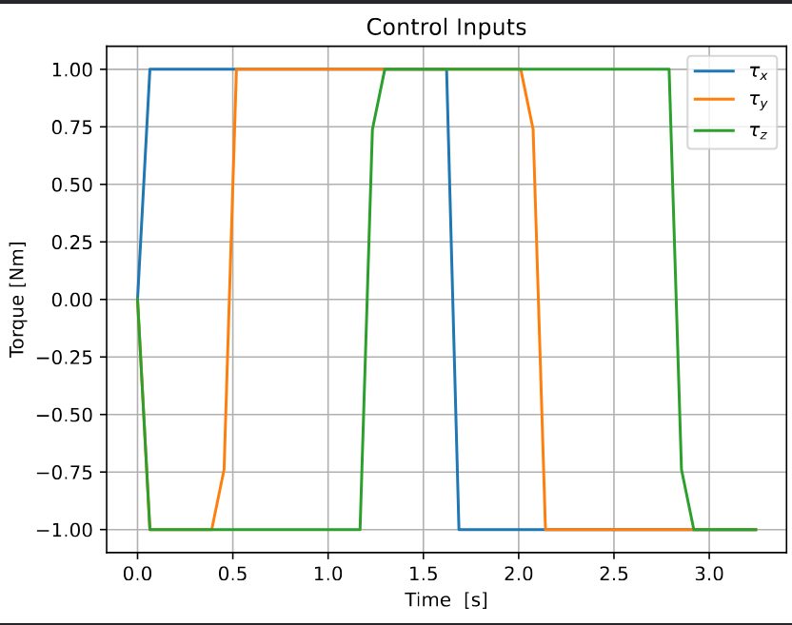
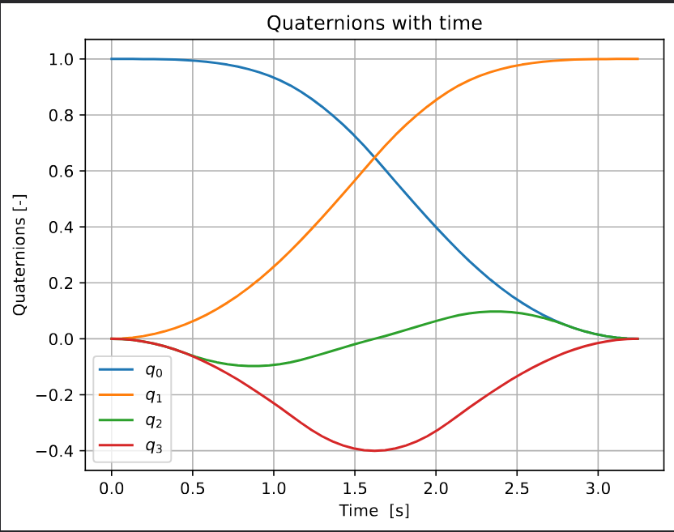
Results
PSO VS Fatrop NLP solvers
Result:
PSO
Fatrop

Slide 12
Results
PSO + Fatrop VS only Fatrop NLP solvers
Result: PSO + Fatrop finds a solution ~2x as fast as only fatrop. T_total < 0.2s
Reason: Fatrop finds a solution much faster with a good initial guess
Conclusion: PSO + Fatrop seems to be the most optimal solver configuration

Slide 13
What‘s Next?
?
Implement and test direct collocation
Experiment with different solvers
Create a Monte Carlo simulation for robustness testing

